Slide 1

Doing Business with CapMetro
“Ride Your Business on CapMetro”
Notes:
Good Day! The following is a presentation provided by CapMetro’s Small Business Programs & Compliance Department on Doing Business with CapMetro!

Slide 2
What you will learn
Services CapMetro provides to the community,
Purchasing processes by dollar threshold,
Where to locate current contracts,
Current bid opportunities,
Future opportunities,
Small business programs, and
Support provided to small businesses
Notes:
This presentation aims to deliver a comprehensive overview of CapMetro, concentrating on the services we provide and the resources you will need to do business with CapMetro. At the end of the presentation, you should understand a little more about the services CapMetro provides to the community, our purchasing processes by dollar threshold, where to locate current contracts, current bid opportunities, future opportunities, and the small business programs we administer and support we provide to small businesses.

Slide 3
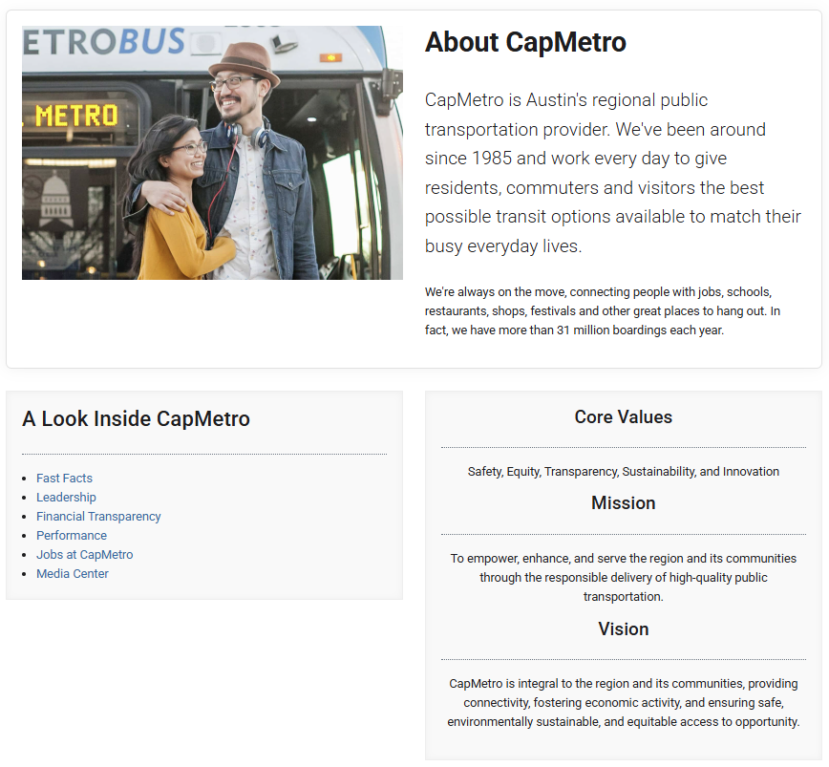
About CapMetro
Learn about CapMetro to understand the service it offers the community, its resources, and other business-related information.
https://www.capmetro.org/about
Notes:
Companies seeking to engage in business with CapMetro should initially familiarize themselves with the identity and operations of CapMetro. To gain insights about CapMetro, please click on the link to our About CapMetro page, which offers details about our Core Values, Mission, Vision, Goals, and Objectives. Additionally, this page includes Fast Facts about the various public transportation services offered by CapMetro and the geographical area that our services encompass.

Slide 4
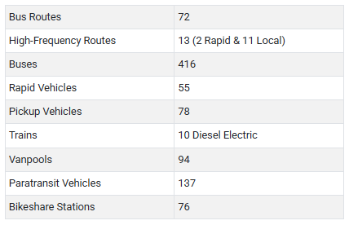
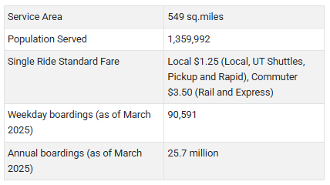
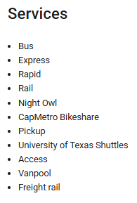
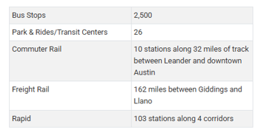
About CapMetro
Logistics
Information available under Fast Facts
Fleet
Notes:
CapMetro’s Fast Facts offers details regarding the various public transportation services available for our customers to choose from, the square mileage that CapMetro covers, and the total number of stations and stops in the region. CapMetro oversees the design, construction, operation, and maintenance of the infrastructure necessary to support the transit services we provide, which includes facilities for passengers, operations, and administration.

Slide 5
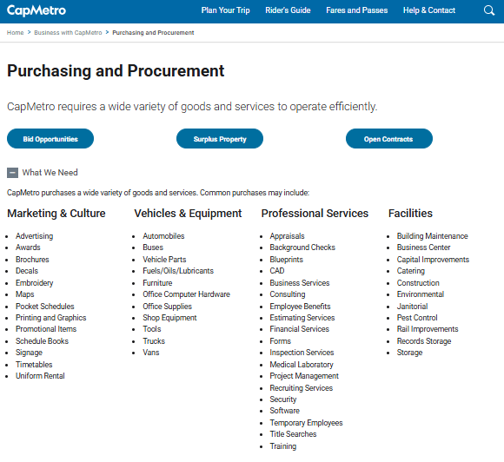
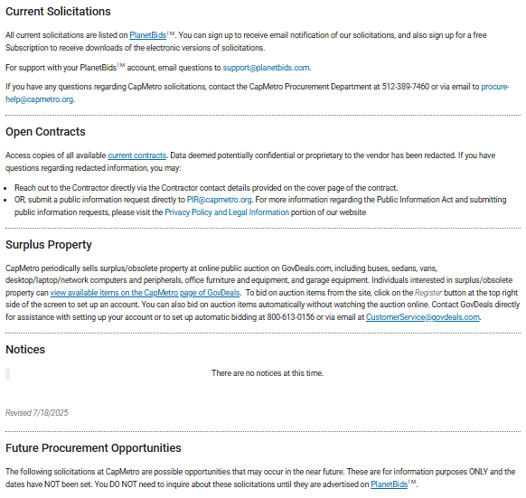
Purchasing & Procurement
What We Need – List of goods & services commonly procured
Bid Opportunities – PlanetBids
Open Contracts – Table providing Contract Information
Future Procurement Opportunities – List of Possible Projects
https://www.capmetro.org/purchasing
Notes:
CapMetro offers valuable resources that assist companies in comprehending our requirements. On our purchasing page, you will discover a compilation of goods and services that are frequently acquired; a link to PlanetBids, which is utilized to request procurement opportunities; a link to open contracts where you can search for and identify goods and services that have been procured in alignment with your business, as well as the corresponding contract; and finally, you will find a list of potential procurement opportunities that may arise in the near future. Please click on the link to access CapMetro's procurement webpage.

Slide 6
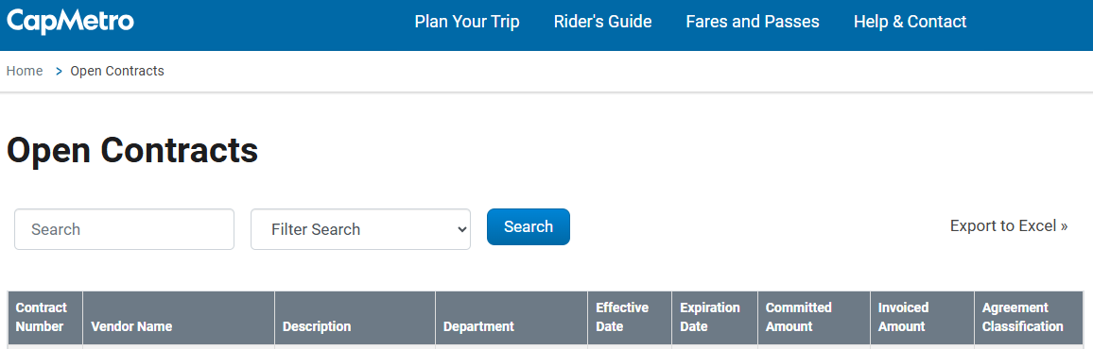
Purchasing & Procurement
Useful Information to Develop a Strategy when trying to do business with CapMetro.
Contract
  Find contacts for Project Manager and Contract Administrator
  Scope of Work and other contract requirements
Expiration Date
  Determine if there are options for renewal, if there will be a re-bid, and timeframe for possible re-bid
Contract Amount
  Determine if your company can be competitive
Notes:
Under Open Contracts, CapMetro offers valuable information that your company can utilize to assess its competitiveness, understand the necessary contract requirements, and identify potential re-procurement opportunities. Through Open Contracts, your company can access all Active Contracts under CapMetro, allowing you to view the vendors involved, descriptions of the work, the departments accountable for the project, the contract expiration date, the committed amount, and much more. By clicking on the Contract Number, you will be directed to the page where the contract is posted. Within the contract, you will find details regarding the scope of work, contact information for the project manager and contract administrator, as well as other essential contract requirements.

Slide 7
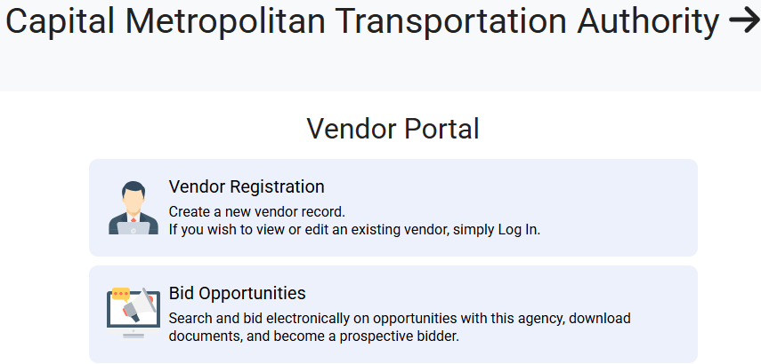
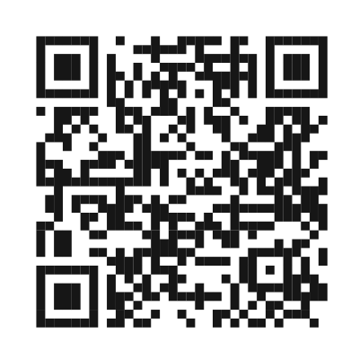
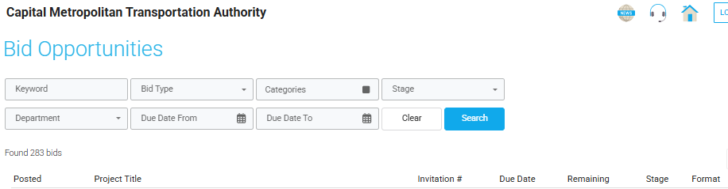
Purchasing & Procurement
https://vendors.planetbids.com/portal/39494/portal-home
PlanetBids
Find Solicitation Opportunities
Find Large Purchases (RFPs & IFBs)
Notes:
CapMetro utilizes PlanetBids, an automated web-based system for managing vendor registrations, bids, and solicitation documents. Registration is complimentary, and vendors who register can download solicitations from CapMetro. This system is used for CapMetro’s larger purchases that include Invitations for Bid and Requests for Proposal. In the Bid Opportunities section, you will find solicitations that include the posted date, project title, invitation number, due date and time for bid submissions, the number of days left for submission, the current stage of the procurement (such as draft, open, closed, awarded, or canceled), and the format of the solicitation (which may be electronic, paper, or both). To access PlanetBids, please click the link or scan the QR code.

Slide 8
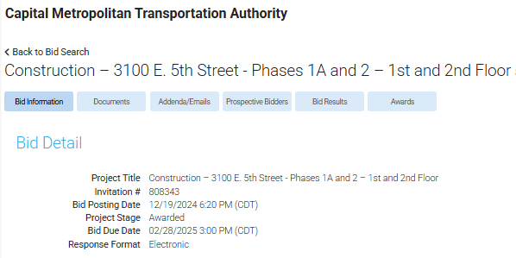
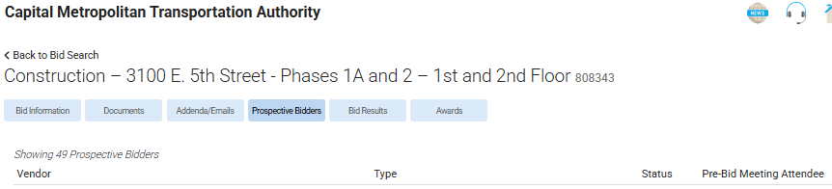
Purchasing & Procurement
PlanetBids
Find Project Details
Prospective Bidders
Find a list of competitors or
subcontractors viewing the project
Notes:
When you choose a solicitation, the information accessible for viewing is comprised of Bid Information, Solicitation Documents, Addendums, Prospective Bidders, Bid Results, and Awards. If you are looking for opportunities as a subcontractor, you can explore the Prospective Bidders to identify who might be placing bids on a project. The information available under Prospective Bidders includes the names of vendors, their addresses, contact persons, phone numbers, email addresses, their small business certification status, their designation as a vendor for this project (i.e., Bidder, Subcontractor, Prime, Supplier, or Other), and whether they participated in the pre-bid meeting. This information is also beneficial for Prime Contractors who wish to understand who their potential competitors may be.

Slide 9
Purchasing & Procurement
Cooperative Contract | Type of Cooperative
Buyboard | Various Goods & Services
Tx Department of Information Resources (DIR) | IT Products & Services
Tx Comptroller Statewide Contract (TxSmartBuy, TxMAS, CCG) | Various Goods & Services
General Services Administration (GSA) | Various Goods & Services
The Interlocal Purchasing System (TIPS) | Various Goods & Services
OMNIA Partners | Various Goods & Services
Note: Cooperative purchases may be posted on PlanetBids
Notes:
CapMetro utilizes a range of cooperative contracts to acquire goods and services. DIR is utilized for the procurement of CapMetro’s IT products and services. Other cooperative contracts are utilized to obtain various office supplies, minor construction work, mechanical services, electrical services, plumbing services, and other goods and services detailed on the purchasing and procurement webpage. If you are interested in bidding on our small purchases, please contact our procurement department. Note, cooperative purchases may be posted on PlanetBids.

Slide 10
Purchasing & Procurement
Purchasing Under 100K
Single Source: Purchases less than $10,000 are single-source. This means that if the price offered is determined to be fair and reasonable and the vendor is able to meet delivery and other requirements, no other vendors are contacted.
Request for Quotes (RFQ): RFQs are used for purchases between $10,000 and $100,000. A brief description of the item or service is provided to vendors, who are notified using a online supplier database, PlanetBidsTM. Interested vendors then submit a written quote to CapMetro by an established deadline. CapMetro may notify additional vendors recommended by a requesting department, the internet, phone books, industry guides, etc.
Notes:
Small purchases are separated into two categories. Those less than $10K and those between $10K and $100K. Purchases less than $10K are single-source. This means that if the price offered is determined to be fair and reasonable and the vendor is able to meet delivery and other requirements, no other vendors are contacted. Purchases between $10K and $100K are conducted through an RFQ. This means a brief description of the item or service is provided to vendors, who are notified using an online supplier database, PlanetBidsTM. Interested vendors then submit a written quote to CapMetro by an established deadline. CapMetro may notify additional vendors recommended by a requesting department, the internet, phone books, industry guides, etc.

Slide 11
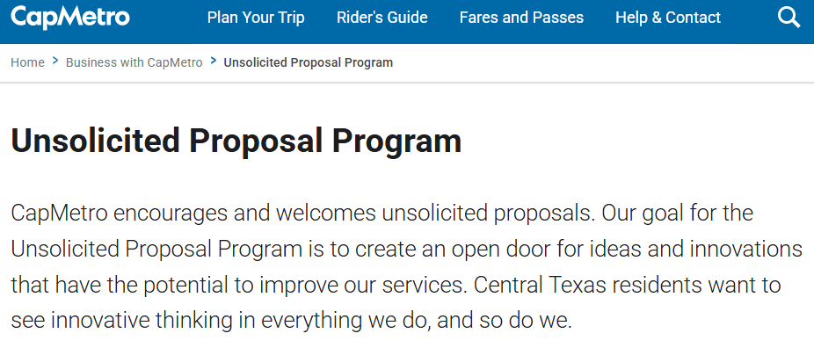
Purchasing & Procurement
A MUST for valid unsolicited proposals:
Be innovative and unique.
Be independently originated and developed by the proposer.
Be prepared without CapMetro supervision, endorsement, direction, or direct involvement.
Include sufficient detail to permit a determination that CapMetro support could be worthwhile, and the proposed work could benefit our mission responsibilities.
Not be an advance proposal for a known agency requirement that can be acquired by competitive methods.
Not be in response to a CapMetro solicitation
Go to Unsolicited Proposal Program – Capital Metro – Austin Public Transit for information on requirements when submitting a proposal.
Notes:
CapMetro actively encourages and welcomes unsolicited proposals. We are consistently seeking ideas and innovations that could potentially enhance and improve our services. Whether it involves reducing costs, introducing a new service, or assisting us in providing a superior experience for our customers, CapMetro is always exploring opportunities beyond our organization for improvement. This program enables CapMetro to receive input from individuals who may not otherwise have the opportunity to contribute. We adhere to a philosophy of continuous improvement and aim to implement experiments and pilot programs that allow us to succeed or fail rapidly. This approach provides us with the opportunity to learn swiftly and grow effectively. Please click on the link to access our Unsolicited Proposal Program webpage. Ensure that you adhere to all requirements prior to submitting your proposal.

Slide 12
Small Business Programs
Small Business Programs & Compliance Department
Manage Disadvantage Business Enterprise (DBE) & Small Business Enterprise (SBE) Program compliance and equal opportunity requirements on CapMetro’s contracts and procurements
Support development of small businesses with the potential to engage in commerce with CapMetro.
Conduct outreach initiatives to source small business to support CapMetro procurement and project initiatives
  1x1 meetings and follow-ups – Must first complete the survey in the Small Business Programs webpage
    Share information on how to do business with CapMetro, local business development centers, etc.
  Participation at external & internal forums
  Conduct surveys to gain information on small business needs and resources aimed at doing business with CapMetro
Collaborate with local organizations, agencies, and companies aimed at small business development and growth.
Overview
Manage Disadvantage Business Enterprise (DBE) & Small Business Enterprise (SBE) Program compliance and equal opportunity requirements on CapMetro’s contracts and procurements | Conduct outreach initiatives to source small business to support CapMetro procurement and project initiatives 1x1 meetings and follow-ups – Must first complete the survey in the Small Business Programs webpage Share information on how to do business with CapMetro, local business development centers, etc. Participation at external & internal forums Conduct surveys to gain information on small business needs and resources aimed at doing business with CapMetro
Support development of small businesses with the potential to engage in commerce with CapMetro.
Collaborate with local organizations, agencies, and companies aimed at small business development and growth.
Small Business Programs
Notes:
The Small Business Programs & Compliance Department oversees the Disadvantaged Business Enterprise Program and the Small Business Enterprise Program, ensuring adherence to program requirements and promoting equal opportunities for small businesses within CapMetro’s contracting and procurement processes. SBPC holds individual meetings and follow-up meetings with businesses to gain insight into the services and products they provide, offer guidance on CapMetro's procurement methods, and disseminate information regarding resources available for business development training focused on growth. Before participating in a one-on-one meeting, businesses are required to complete the small business survey available on the small business program’s webpage. Please click the link to access the survey. Additionally, SBPC partners with external organizations dedicated to fostering small business development and participation.

Slide 13
Small Business Programs
Disadvantaged Business Enterprise (DBE) | Small Business Enterprise (SBE)
Ensure nondiscrimination in the award and administration of CapMetro contracts Create a level playing field on which DBEs/SBEs can compete fairly for contracts Assist the development of firms that can compete successfully in the marketplace
Administered in accordance with Title 49 C.F.R. Part 26 & USDOT guidance. For-profit small business At least 51% owned by one or more socially and economically disadvantaged individuals who must control the business decisions and manage day-to-day operations Qualifying owners are U.S. Citizens or Permanent Residents Meets the Small Business Administration’s size standard and does not exceed $23.98 million in gross annual receipts (5-year average) TUCP Members that Certify DBEs City of Austin City of Houston Corpus Christi Regional Transportation Authority North Central Texas Regional Certification Agency South Central Regional Certification Agency Texas Department of Transportation | Administered in accordance with Texas Transportation Code, Title 6, Subtitle K, Chapter 451, Subchapter A, Subchapter F, Section 451.251 – 451.253 CapMetro accepts certifications under its SBE Program that meets the Small Business Administration’s size standards that include: Small Business Enterprise (SBE), Disadvantaged Business Enterprise (DBE), Historically Underutilized Business (HUB), Minority Business Enterprise (MBE), Women Business Enterprise (WMBE), and Small Business Administration (SBA).
Small Business Programs
Notes:
The following slide shares information addressing the certifications CapMetro recognizes. Each of these small business programs has distinct certification requirements. It is important to note that CapMetro does not provide certification for the small businesses related to the certifications mentioned on this page. The agencies responsible for certifying DBE are listed. Please click on the link to access a list of additional certifying agencies and other resources available for small businesses.

Slide 14
Contacts & Resources
CapMetro’s Vendor Guide: https://www.capmetro.org/vendors PlanetBids https://pbsystem.planetbids.com/portal/39494/help (818) 992-1771, available between 9am and 7pm CST Procure-help@capmetro.org Phone: 512-389-7460 | Small Business Programs & Compliance (SBPC) Email: SBPC@capmetro.org Link: https://www.capmetro.org/dbe
Interested in Public Meetings? Public Involvement Board Meetings Community Engagement Customer Advisory Committees | How to connect with CapMetro? Website: www.capmetro.org Twitter: @CapMetroATX Instagram: @capmetroatx Facebook: CapMetro YouTube: CapMetro LinkedIn: CapMetro
Notes:
As we reach the end of this presentation, we trust that the information shared has been useful. Below, you will find additional resources along with the email address for the Small Business Program & Compliance Department, which can provide you with more information about Doing Business with CapMetro.

Slide 15
Notes:
We hope the information provided in this presentation has been helpful and our SBPC Team is ready to connect with you!

