Slide 1
North Base Demand Response Operations and Maintenance Facility & Centralized Warehouse

Slide 2
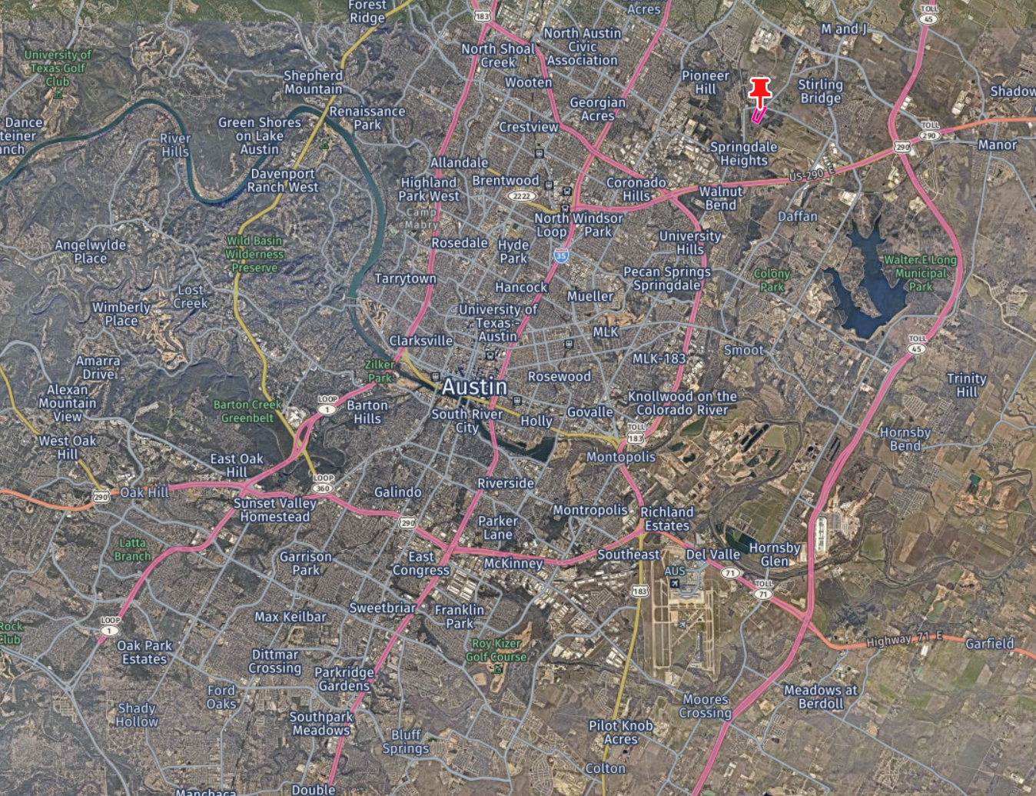
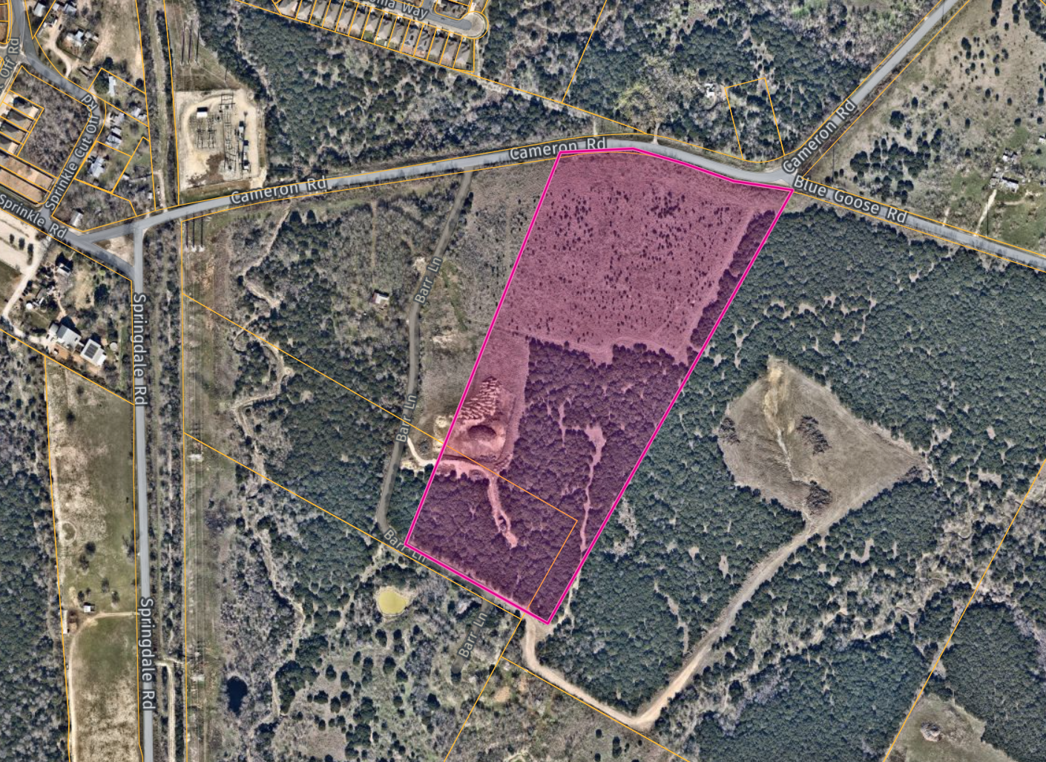
Location
Project Location
25 Acre Site
Cameron Road & Blue Goose Road
(Near Springdale Rd)
Vicinity Map – Northeast Austin
2

Slide 3
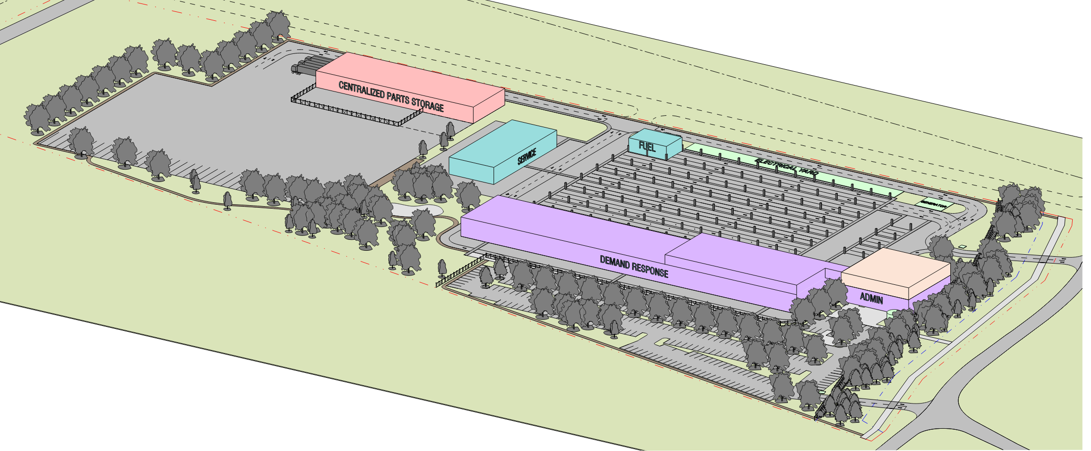
Proposed Site Plan (15% Design)
Maintenance & Operations Functions:
220 vehicles
Vehicle maintenance bays
Fueling & service islands
OPS & admin staff
Dispatch
Customer call center
Central Warehouse & storage
Bus course training area
Training & conference rooms
Visitor & staff parking
Provisions for future ZEB fleet
New off-site utility connections
Preliminary rendering; not final design.
3

Slide 4
Highlights
Thoughtfully designed facility that accommodates the growing MetroAccess and Pickup fleets and generates workforce opportunities
No displacement of residences or businesses.
Project includes a $20M Bus & Bus Facilities grant from FTA
Public art component will be included
A multi-use, community space will also be included
New centralized warehouse will accommodate agency-wide storage of parts and materials
Sustainable design features (LEED Silver or greater)
National Environmental Policy Act (NEPA) - Clearance with FTA recently completed under a Categorical Exclusion
4

Slide 5
Highlights Cont.…
Key activities currently underway:
Traffic Impact Study with Travis County
Title VI Equity Analysis
Utility coordination with Austin Water Utility and Austin Energy
Community engagement late Summer 2023
Preliminary Schedule:
15% Design recently completed
30% Design will begin late Summer 2023
Final design and permitting during 2024
Construction will begin 2025
Facility operational in 2027
5

Slide 6
Community Engagement
Purpose: Effectively and accessibly communicate with the community, gather valuable input, and address potential community concerns related to the North Base Demand Response Facility and Centralized Warehouse.
Tools:
The Project Webpage: https://www.capmetro.org/northbase
Survey: https://publicinput.com/demand-response-facility
Post-cards mailed to surrounding residences.
Direct emails to local businesses, schools, organizations and neighborhood associations.
Public meetings
Geo-targeted social media posts
Language translation and interpretation services

Slide 7
Stay Informed
https://www.capmetro.org/northbase
Reach out to engage@capmetro.org with any project questions you may have!
7
Notes:
The project website is the main source for project information: https://www.capmetro.org/northbase
Sign-up to receive future project updates & complete a short survey: https://publicinput.com/demand-response-facility
Postcard mailers have been sent out to surrounding areas.
Keep an eye out for future project updates on CapMetro social media sites (Facebook, Twitter)
Community Engagement materials include translations into Spanish and Vietnamese, with additional translation options available upon request, plus screen-reader friendly online materials for persons visually impaired.

